Slide 1
EECS E6895 - Milestone 1 COVID-19 Risk Prediction via Bayesian Network
A11: Reasoning (Understanding Causalities via Bayesian Network and/or others)
Yiwen Fang (yf2560) | Guoshiwen Han (gh2567)

Slide 2
Task Goal
Literature Survey
Methodology
System
Timeline
Q&A

Slide 3
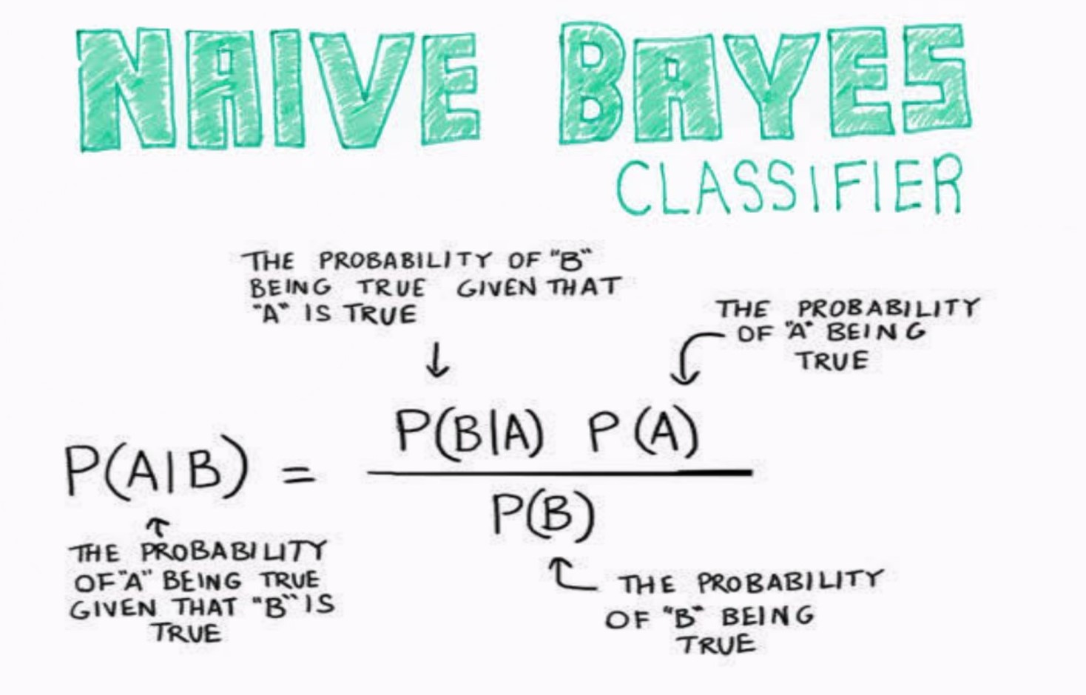
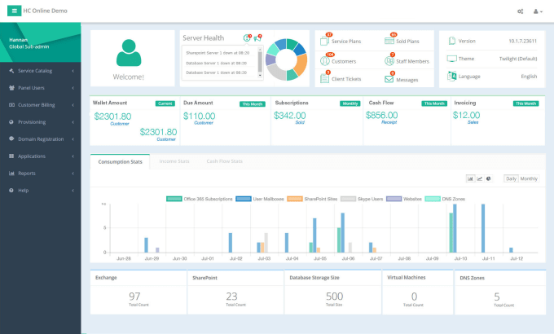
Task Goal Achievement: Get user input, train a Bayesian model, predict the probability of risk, output to user
Training Data
User Input
Probability Prediction
Process
Testing & Validation
Bayesian Model
Underlying Algorithm & UI
Task Goal
Literature Survey
Methodology
System
Timeline
Source: https://medium.com/@pranav3nov/naive-bayes-for-machine-learning-b81ddf954031 | https://www.fiverr.com/sulehrinauman/design-creative-dashboard-admin-panel-ui-with-fully-responsive

Slide 4


Task Goal Three reasons making the research and development important, user interaction, prediction, adaptive model
Interaction
Prediction
Adaptive Model
Interactions between users and web application, e.g., receiving user input and generating output back to users
Prediction/forecasting future status
Dynamically update the model in a proper frequency, e.g., every week, since the virus variation and the sample data is keeping updated
Training Data
Automatic
Testing & Validation
Bayesian Model
Task Goal
Literature Survey
Methodology
System
Timeline

Slide 5

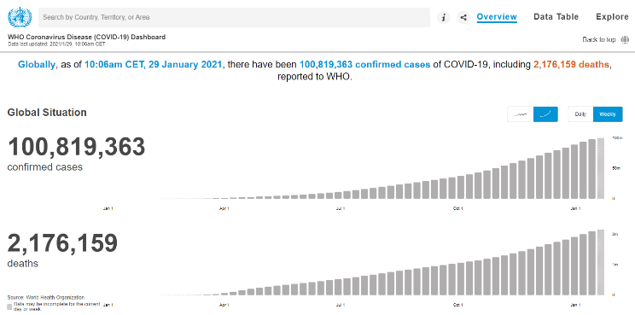

Task Goal Three big data challenges: volume, velocity, variety
Volume
Velocity
Variety
COVID-19 data is expanding globally
Data import, cleaning, model training
Various types, e.g., geographical coordinates, time, amount, statistical ratio, resources
Task Goal
Literature Survey
Methodology
System
Timeline
Source: WHO

Slide 6
Task Goal
Literature Survey
Methodology
System
Timeline
Q&A

Slide 7
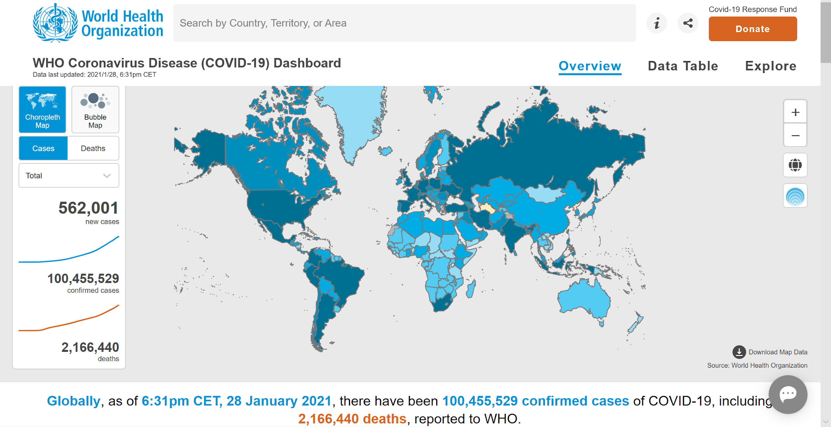
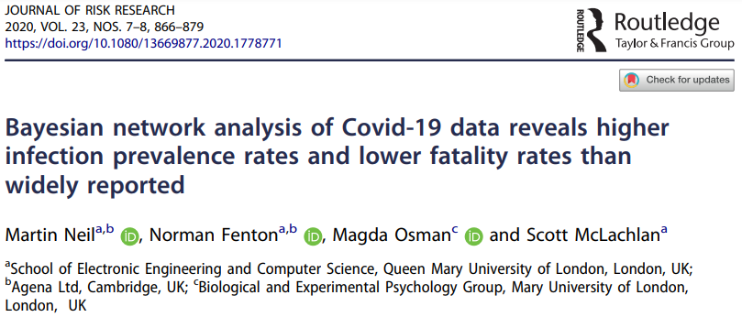
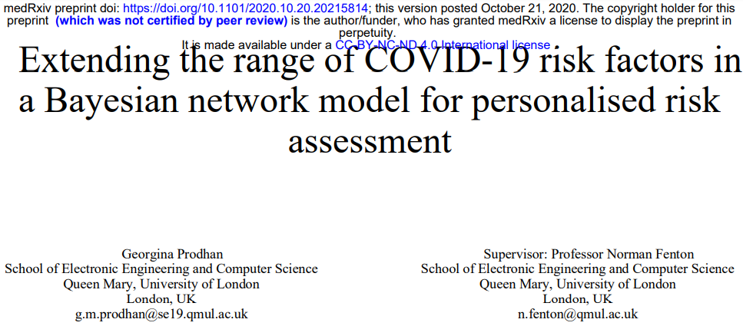
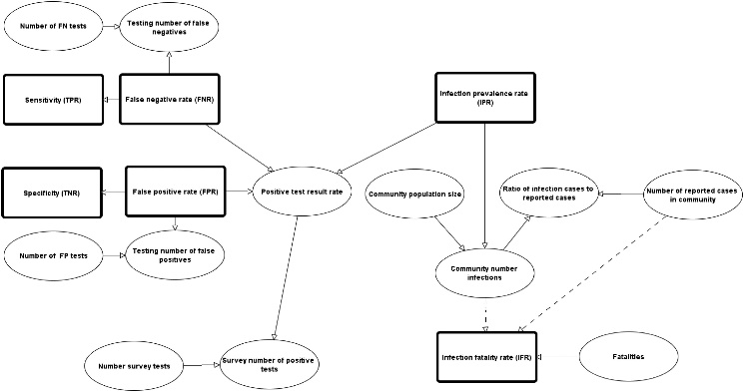
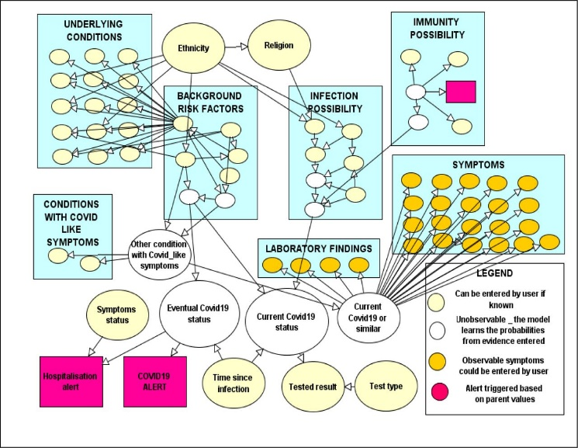
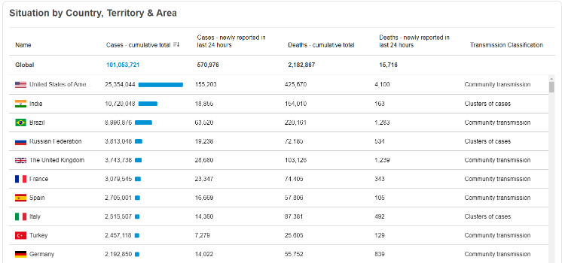
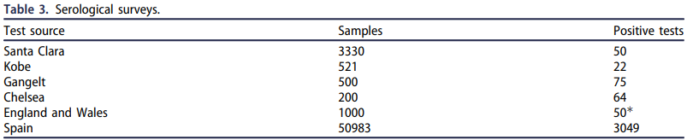
Literature Survey Previous work includes data collection, confirming the conjecture based on serological testing, calculating probability
Data Collection
Confirming the Conjecture
Calculating Probability
WHO collect the data all over the world and draw out the trend line
Based on Covid-19 serological testing, use Bayesian network analysis to confirm the conjecture of the bias of reported data
This paper presents an extension of an existing Bayesian network model for an application in which people can add their own personal risk factors to calculate their probability
https://covid19.who.int/
https://www.tandfonline.com/doi/full/10.1080/13669877.2020.1778771
https://www.medrxiv.org/content/10.1101/2020.10.20.20215814v1
Task Goal
Literature Survey
Methodology
System
Timeline

Slide 8











Literature Survey Unlike the statistical software used in the papers such as AGENARISK, Python is used as the underlying language for modelling to integrated with other functions
Tools
Utilizations
Python and its packages are powerful for Bayesian model training
Unlike the statistical software used in the previous papers, model trained from Python is easy to be integrated with code of the web application
Model
Web Application
Django is a web framework integrated with frontend and backend, which is more powerful than Flask
Database
NoSQL is a better database choice than SQL due to the flexibility and speed. Spark is a candidate for big data database
Server
Deploying to the cloud ensures remote access, distribution, and scalability
Matplotlib is easy to be integrated with Python
Flourish is an commercial software best for dynamic running bar
D3 is easy to be integrated with JavaScript
Visualization
Task Goal
Literature Survey
Methodology
System
Timeline

Slide 9
Task Goal
Literature Survey
Methodology
System
Timeline
Q&A

Slide 10
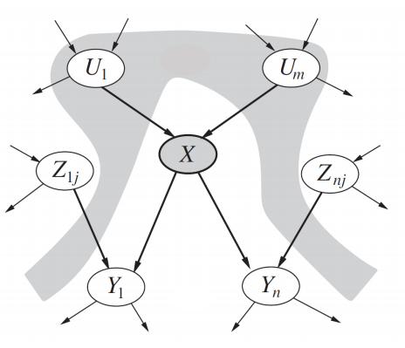
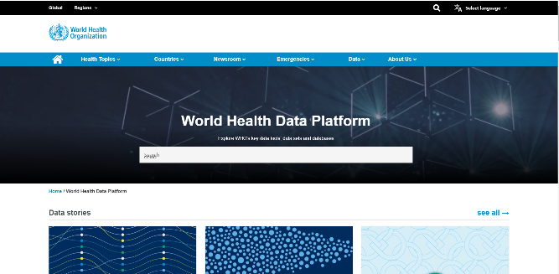
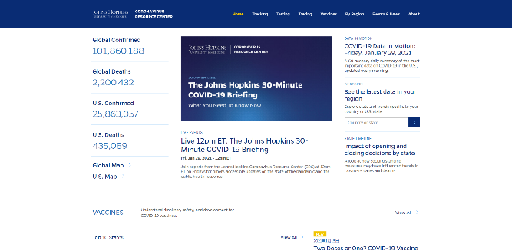
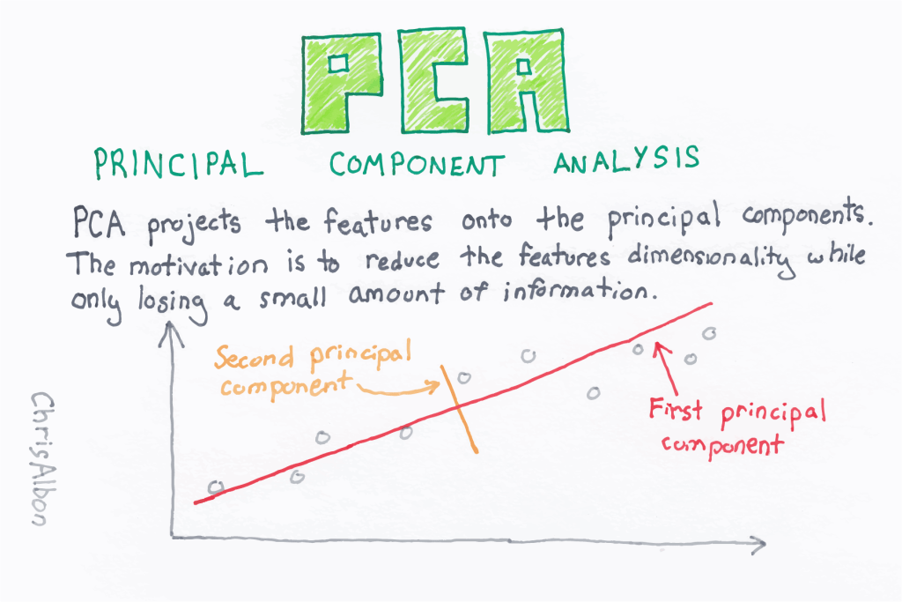
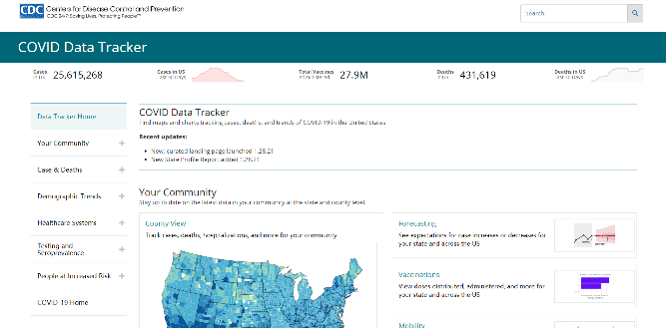
Methodology Implemented algorithms are Bayesian network and PCA. Existing dataset is preferred but could be adjusted later
Algorithm
Dataset
Bayesian Network
Principal component analysis (PCA)
Existing dataset is preferred
WHO, Johns Hopkins University, CDC
Task Goal
Literature Survey
Methodology
System
Timeline
Source: WHO, JHU, CDC

Slide 11
Task Goal
Literature Survey
Methodology
System
Timeline
Q&A

Slide 12
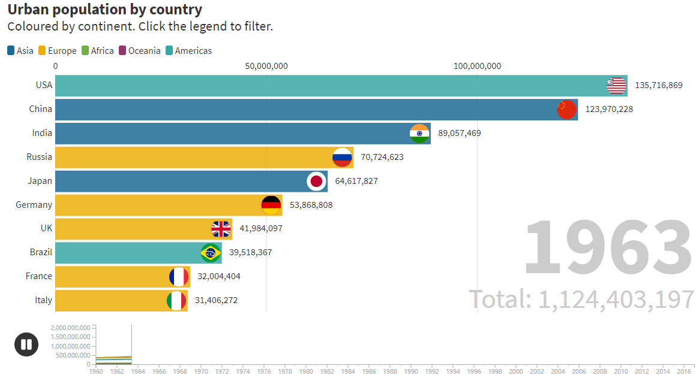
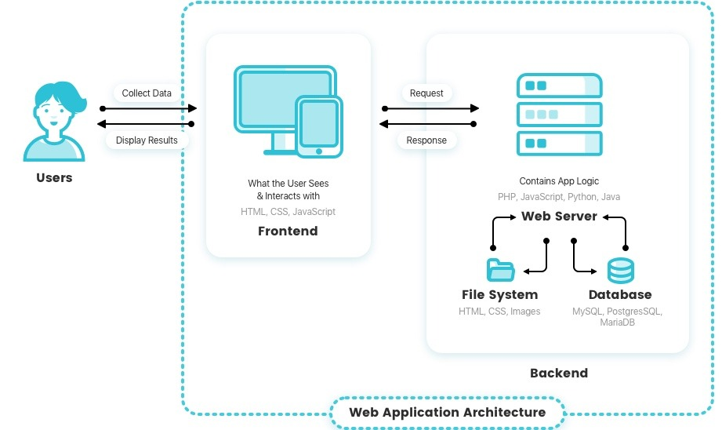
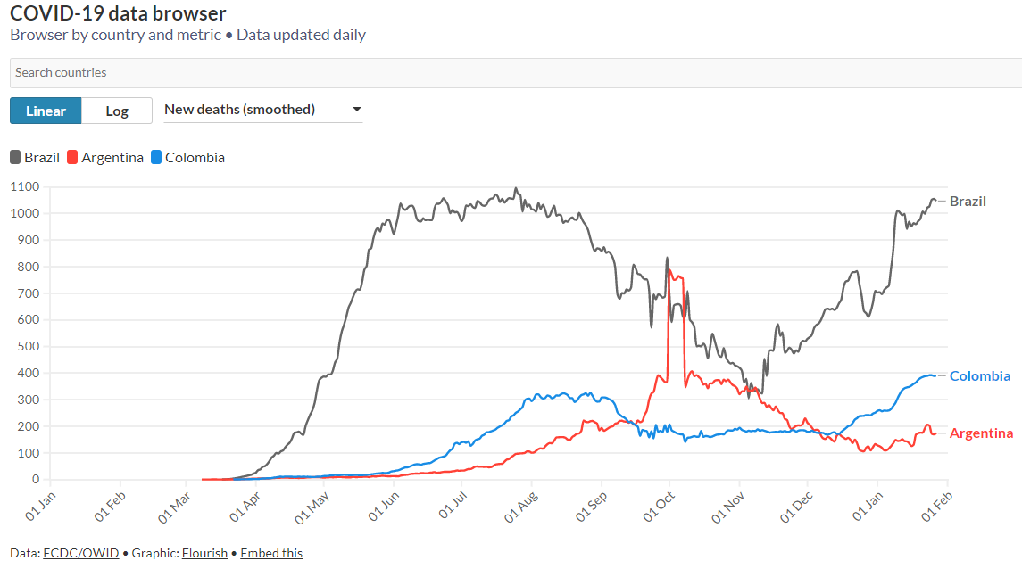
System The final system is a web application integrated with frontend, backend, model. Outcome is given back to the user via various visual graphs/tables
Final System
Visualization & UI
Model is presented via a web application
Frontend accepts user input and transfer it to backend via API
Backend receives the input data and model process the input parameters
After model finishing processing, backend output the results to the frontend to the user
Any detailed system design would be discussed later
Visualization is realized via tables, static graphs, dynamic graphs
UI enables the user to zoom in for the detailed or zoom out for the scope of results
UI interacts with the user by accepting user input
Task Goal
Literature Survey
Methodology
System
Timeline
Source: https://reinvently.com/blog/fundamentals-web-application-architecture/ | https://flourish.studio/examples/

Slide 13
Task Goal
Literature Survey
Methodology
System
Timeline
Q&A

Slide 14
Timeline Milestones 2 and 3, and final project are split into data processing, modelling/web developing, deploying/extending
Milestones 2
Milestones 3
Final Project
Data collection and procession
Determine the training method of the model
Coding work
Model training and evaluation
Frontend, backend, API, database
Deployment and testing
Extend the result to other factors such as social indicators
Task Goal
Literature Survey
Methodology
System
Timeline

Slide 15
Task Goal
Literature Survey
Methodology
System
Timeline
Q&A

Slide 16
Q&A

